Slide 1
Product Update
January 26, 2021

Slide 2
Product Management team
Ted Hertz VP Product Management
Troy Nuttall VP Product Development
Enstar Manufacturing in Korea
Joe McNulty VP Product Development
Ted
20+ years experience POU, Bottled water, Coffee, Drinking fountains
Troy
18+ years experience POU
Comes from Wellsys
Joe
16+ years experience HORECA, Sparkling and flavored systems
Comes from Vero
Enstar
Quality manufacture in Korea
Q12, PWT products

Slide 3
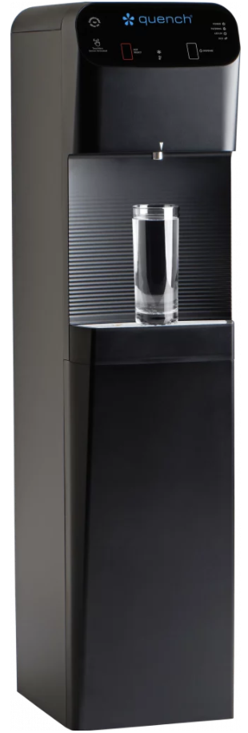
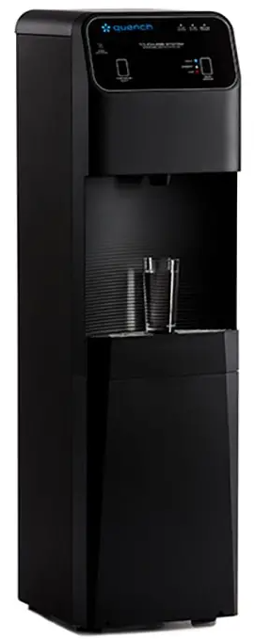
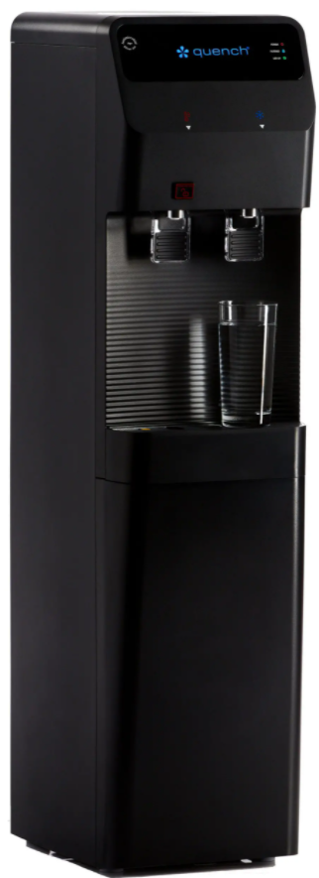
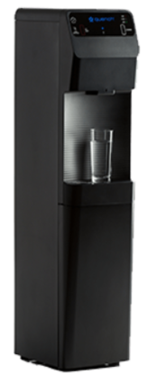
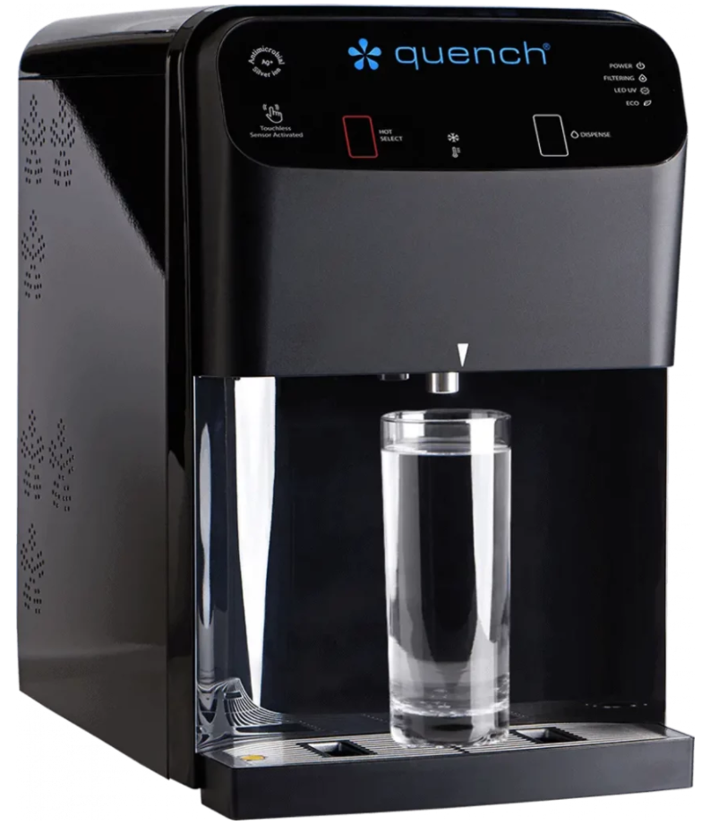
2021 accomplishments and 2022 objectives
Products launched for Direct in 2021 fill out BFC line
Q8FS
Q8CT
Q4FS
Q3FS
Q12FS
CTE models (extended chassis with internal filters)
2022 will focus more on ice, sparkling and flavors

Slide 4
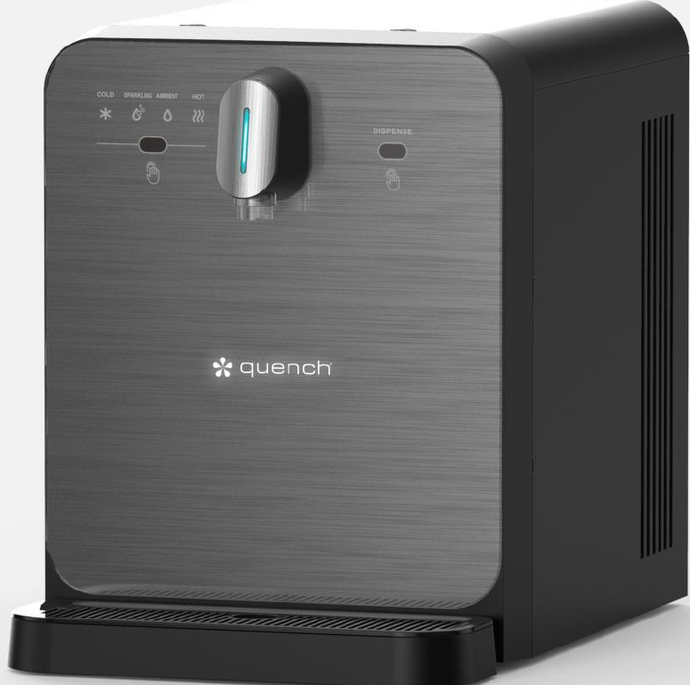
Touchless Sparkling coming Q3 2022
QS4 – tentative name
Touchless
Sparkling, Hot, Cold and Ambient
Leading chilling performance
Glass front with Illuminated logo
Under 18” high
Launch Q3, 2022

Slide 5
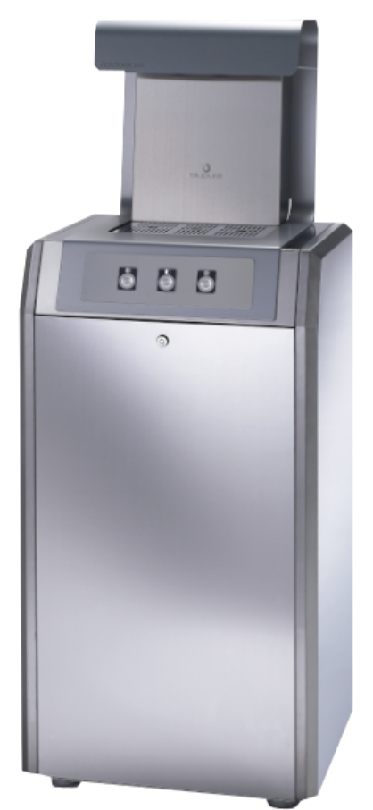
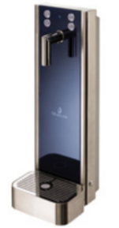
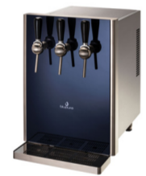
Sparkling offerings being updated throughout 2022
Goal: to be more competitive in both offices and HORECA channels with better performing, more stylish products
Bluglass line
Blutower as an alternative to the ViTap
Bluglass 80 to replace the current 555
Quench QS4 to replace the 523/528
Blupura FS as an alternate to the 570-FS
More changes are likely
Launch ongoing during 2022

Slide 6
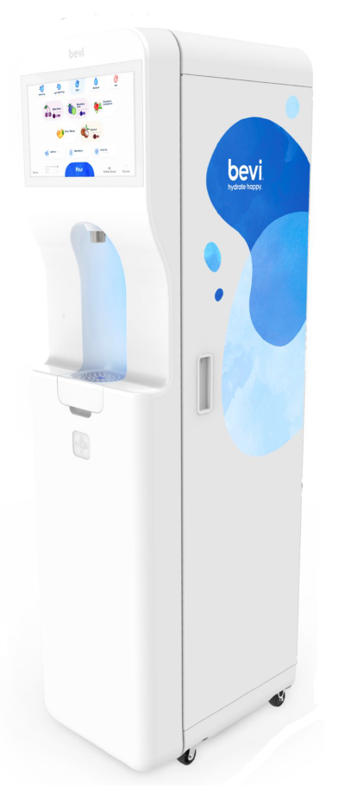
Bevi 2.0 expected June/July 2022
Bevi is selling direct as a test to learn what adjustments are needed
Improved UI
More flavor options
Enhancement options
We expect a sample in April
Pricing will be higher
Access to sell in late June/July

Slide 7
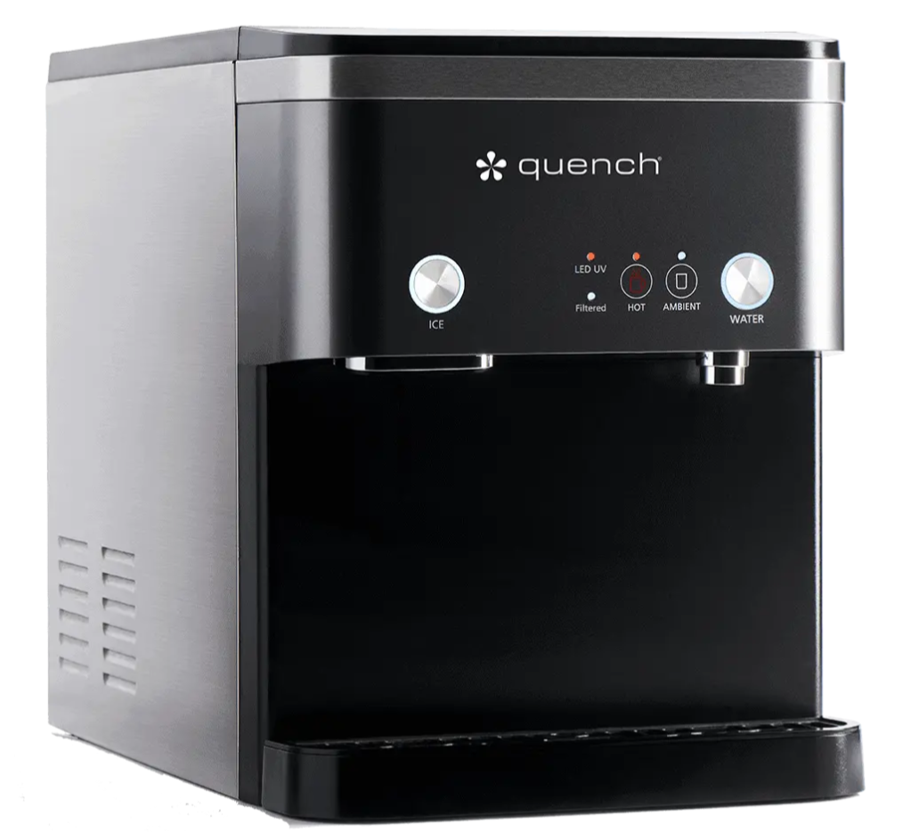
Modified 960/965 due March 2022
The 965 has been limited to RO only installations
Ice machines are sensitive to scale
Nugget ice machines are more sensitive
We have modified the design to improve performance with TDS, without RO
Now 3 options for installation
Without RO up to 300 TDS (Good)
With RO* (Better)
Use optional drain pump* (Best) *Requires drain
Launch March/April, 2022

Slide 8
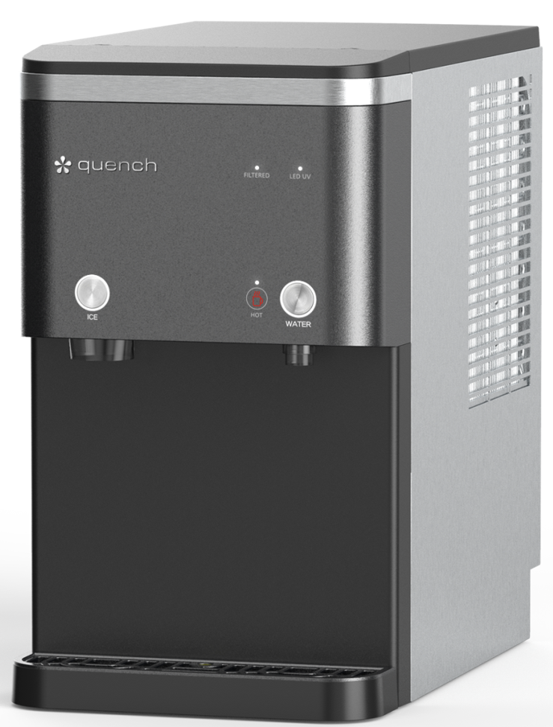
Quench 960-16 / 965-16 due Q4 2022
New 16 lb. ice to replace 970-15 and 975-15
16 lbs. storage and 165 lbs. ice making capacity
975-15 = 15lbs storage and 125lbs ice making capacity
LED UV in ice bin
No RO up to 300 TDS
Same connection options as the modified 965
Touchless Handsfree Module available
Launch Q4, 2022

Slide 9
Quench 950 V.2 due Q4 2022
New high-end look for the 950
Feature upgrades:
Touchless
10” dispense area
UV
Air filter
The indirect version is the best-selling SKU
Over 6,000 in 2021
Quench sales performance could be much better
Launch late Q4 2022

Slide 10
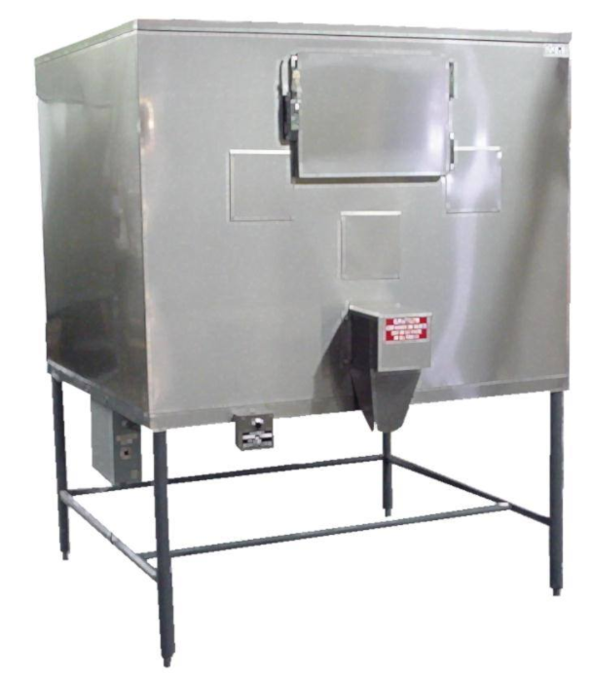
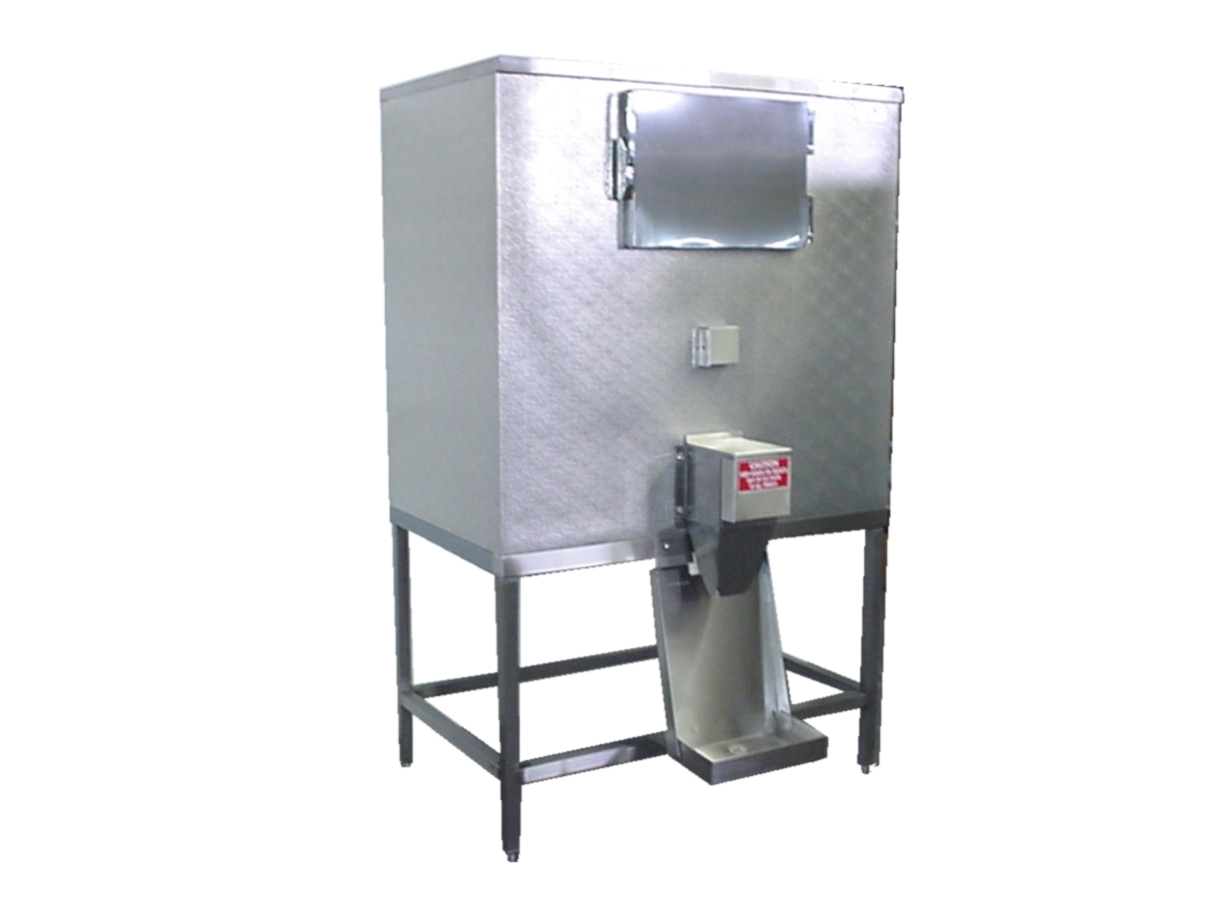
Ice baggers roadmap
Follett has faced long delays due to their supply chain issues
Evaluating manufacturers other than Follett
Hoshizaki
MGR
Launch nationwide in late Q1 2022

Slide 11
Closing thoughts
The Q12 is likely the best performing cooler in the market – Sell it!
The 950 is the best performing machine for the Indirect side – Customers love it!
The 965 has been a solid performer when paired with RO
Service is comfortable with RO installations, and we could be selling far more than we do. RO offers a great customer experience

