Slide 1
Sales Enablement
January 26, 2021

Slide 2
Enablement topics for today
What is ‘Sales Enablement?’
New Sales Tools + Visibility
Customer Service Transformation: Quality First
Overview of the Sales Enablement function and key goals for 2022
Introduction of new tools and data visibility for 2022
Overview of the Customer Service Transformation set to launch across Customer Care, Field Service, and Supply Chain

Slide 3
Enablement topics for today
What is ‘Sales Enablement?’
New Sales Tools + Visibility
Customer Service Transformation: Quality First
Overview of the Sales Enablement function and key goals for 2022
Introduction of new tools and data visibility for 2022
Overview of the Customer Service Transformation set to launch across Customer Care, Field Service, and Supply Chain

Slide 4
Meet the Enablement team
John Whalen SVP Sales, Marketing, Customer Care
Core focus areas:
Training:
Combined across Care and Sales
Focus on consistency + high quality
Content for new hires and existing employees
Sales Operations:
Expanded team
Support the core; add on backlog mgmt. + reporting
Streamline the repeatable, provide more strategic support
Pricing:
Maximize value across multiple pricing levers
Provide Managers and reps with better visibility and tools to realize more price
Kit Neuman
VP, Strategy and Business Intelligence
VP, Operations and Enablement – Direct
Rachael Borzillo
Sr. Manager of Training and Enablement
Scott Dollahon
Sr. Manager of Sales Operations
Trevor Shelbo
Pricing Strategy Manager
Cindy John
Sales Ops Supervisor
Steven Persons
Sr. Trainer
Janna Zenchenko
Sales Ops Specialist
Kyra McGrath
Trainer
Amy Pham
Sales Ops Specialist
2 more Sales Ops Specialists to be added by April
Jodi Burnett
Sales Ops Specialist
Chelsea Lewallen
Sales Ops Specialist
Training
Sales Operations
Pricing

Slide 5
Enablement goals for 2022
Increase productive engagement with the sales team: more time side-by-side, directly with you
Contribute to executing the 2022 plan: deliver training, on-time cases, pricing analyses, market-specific support, etc.
Define the future of enablement: outline the highest value use of Enablement team time and attention

Slide 6
Enablement topics for today
What is ‘Sales Enablement?’
New Sales Tools + Visibility
Customer Service Transformation: Quality First
Overview of the Sales Enablement function and key goals for 2022
Introduction of new tools and data visibility for 2022
Overview of the Customer Service Transformation set to launch across Customer Care, Field Service, and Supply Chain

Slide 7
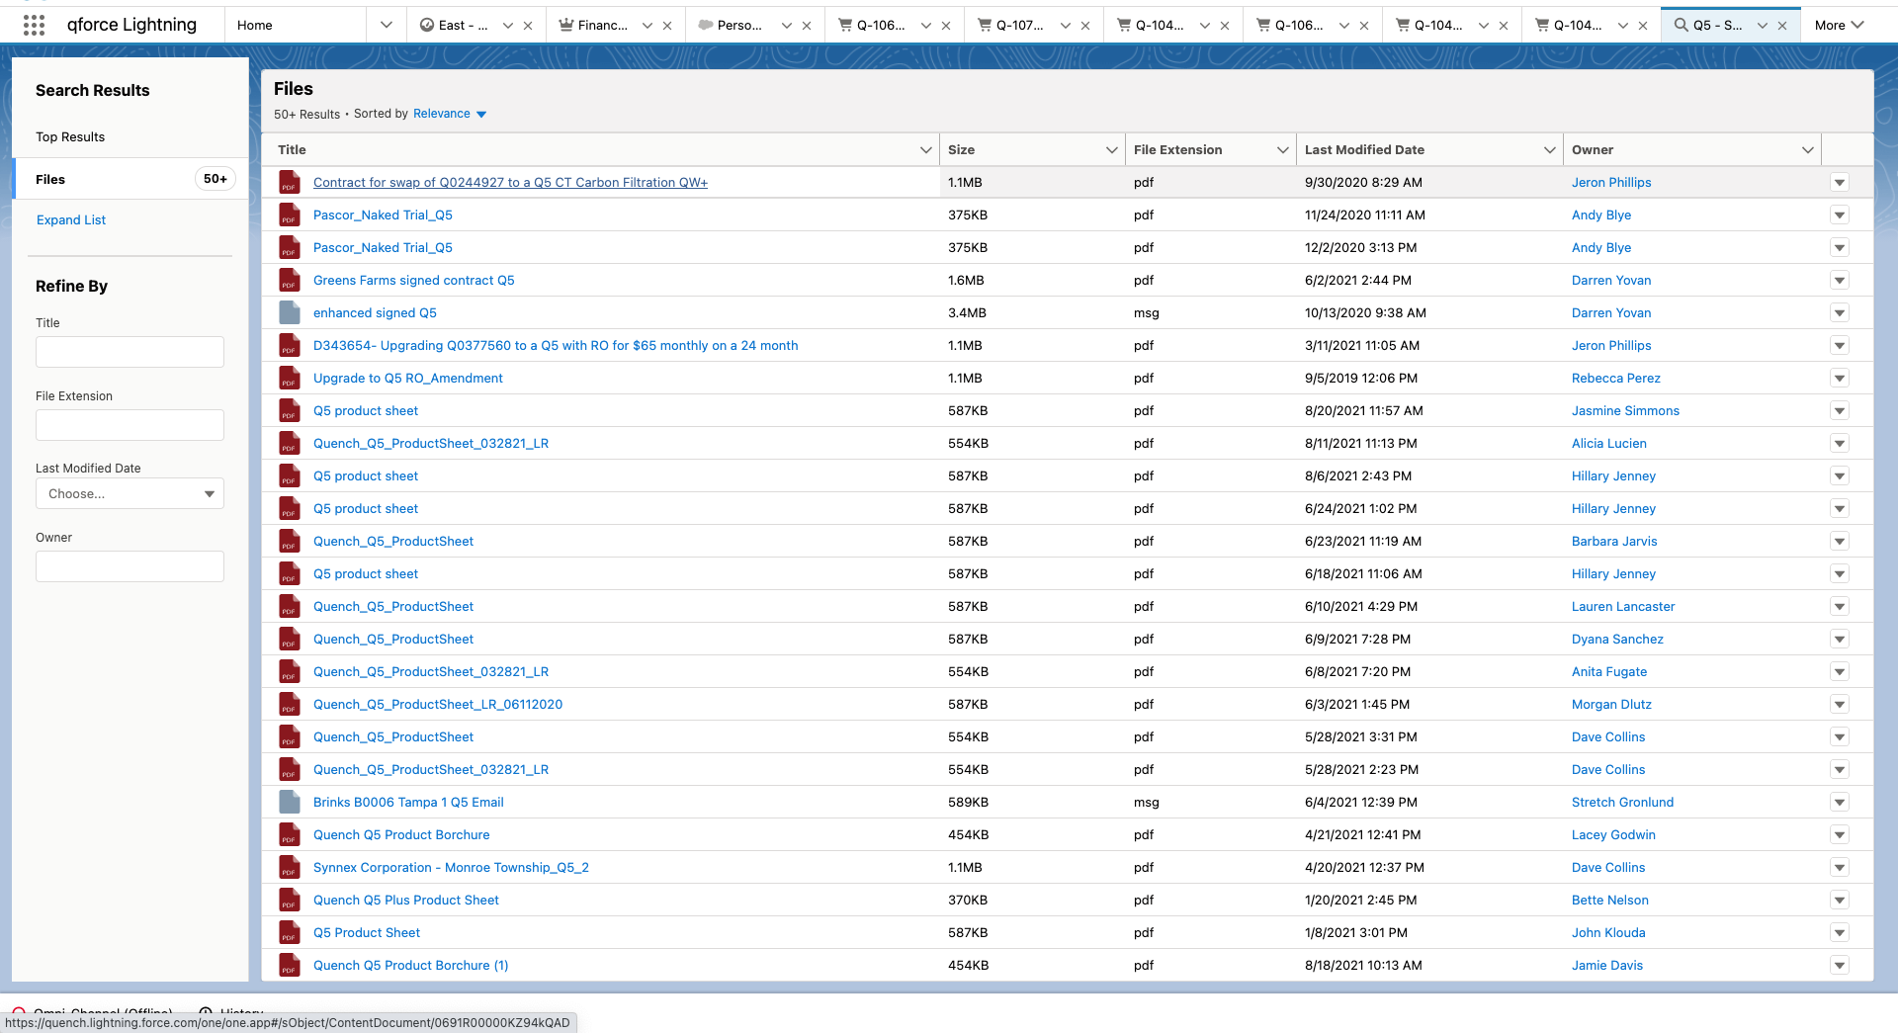
New tools – HighSpot
Which would you pick to send to a customer interested in a Q5?

Slide 8
New tools – HighSpot
What HighSpot delivers
Intuitive interface for users to interact with content/collateral
Built for Salesforce, easy to find
No file size limitations
Activity is marked in Salesforce
Reporting tools allow for tracking end-user engagement with content
Suggested content based on vertical/persona and previously successful collateral
Why this benefits YOU
Reps/Marketing spend less time looking for content
Reps can create custom, engaging curated landing pages with sent collateral
Structured onboarding and training through vertical/persona collateral “plays”
Drives consistent execution in messaging and programs
Track effectiveness of sales collateral – concentrate on producing more content that leads to more closed-wins

Slide 9
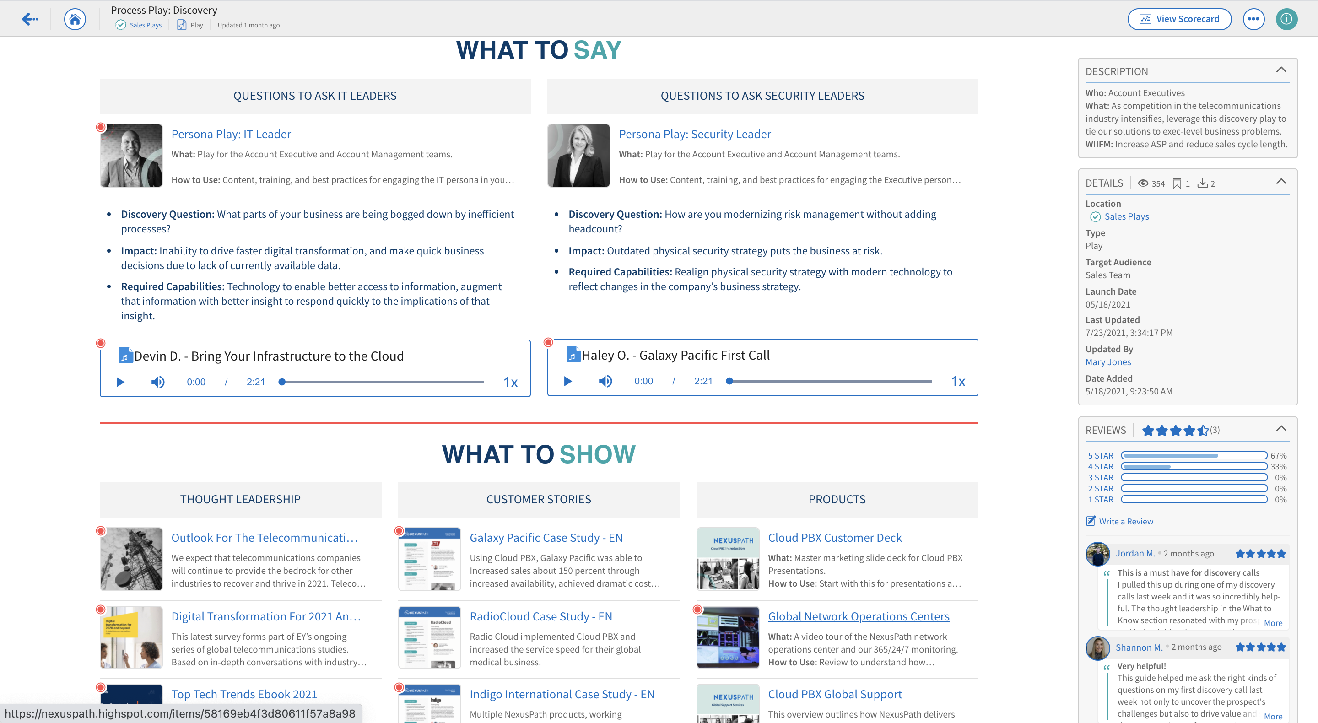
New tools – HighSpot
Example Sales Plays: How Marketing can build out “Sales Plays” for products, segments (verticals), or personas

Slide 10
New tools – HighSpot
Example customized landing page for prospects
Easy to update prospect logo to provide custom look and feel
Key stats for why Quench is a winning choice for customers
Selected collateral that is up to date and vertical industry-specific
All easy to set up by reps (<15 min per page), with the latest collateral at your fingertips

Slide 11
When to expect HighSpot
Configuration (led by Megan and in partnership with IT) happening now
Available to all Field and Inside reps early March!
Training and set-up guides to be provided in advance
Will evaluate benefits and usage throughout 2022

Slide 12
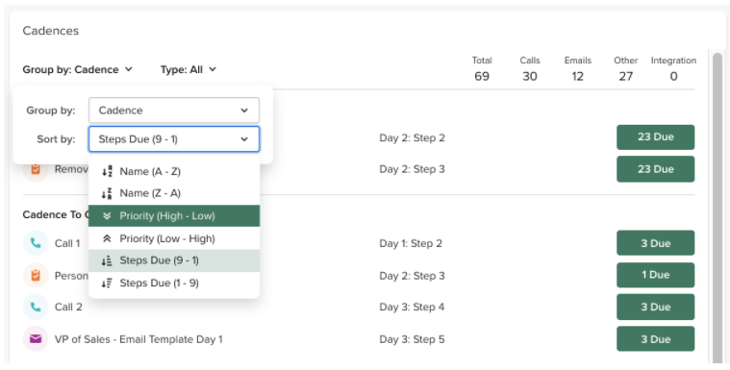
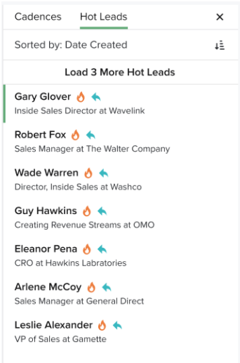
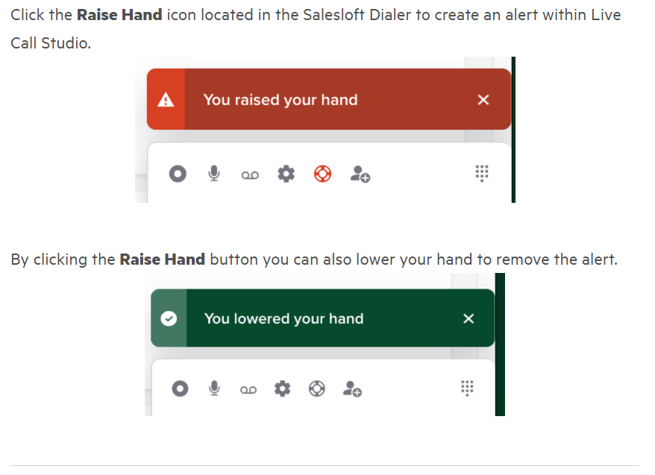
New tools – SalesLoft
Maximize opportunities and revenue through improved lead engagement, prioritization, and coaching
Automatically defined lead contact cadences
Priority lead scoring
Live in-call management coaching or support

Slide 13
New tools – SalesLoft
What SalesLoft delivers
Why this benefits YOU
Automated lead cadence
Lead Scoring
The Dialer (local number)
Activity auto-logged in QForce
Live Call Studio – management can listen in or join live calls
Evolving Workflows – upgraded analytics on what is working
Increased lead-to-opportunity conversion rates
More opportunities = More Revenue
Increased pipeline visibility
Live on-call coaching and mgmt support
Continuous improvement based on smart feedback

Slide 14
When to expect SalesLoft
Configuration (led by Kevin and in partnership with IT) happening now
Available to all Inside reps February 1st!
Training and set-up guides to be provided in advance
Will evaluate benefits and usage throughout 2022, including for potential broader rollout

Slide 15
New tools – 360 account visibility
Cross-functional sessions in November highlighted the need for account-level detail on:
Work orders
Cases
Calls
Installed products
Renewal dates
Upcoming invoices
Launching in Qforce 2/1:

Slide 16
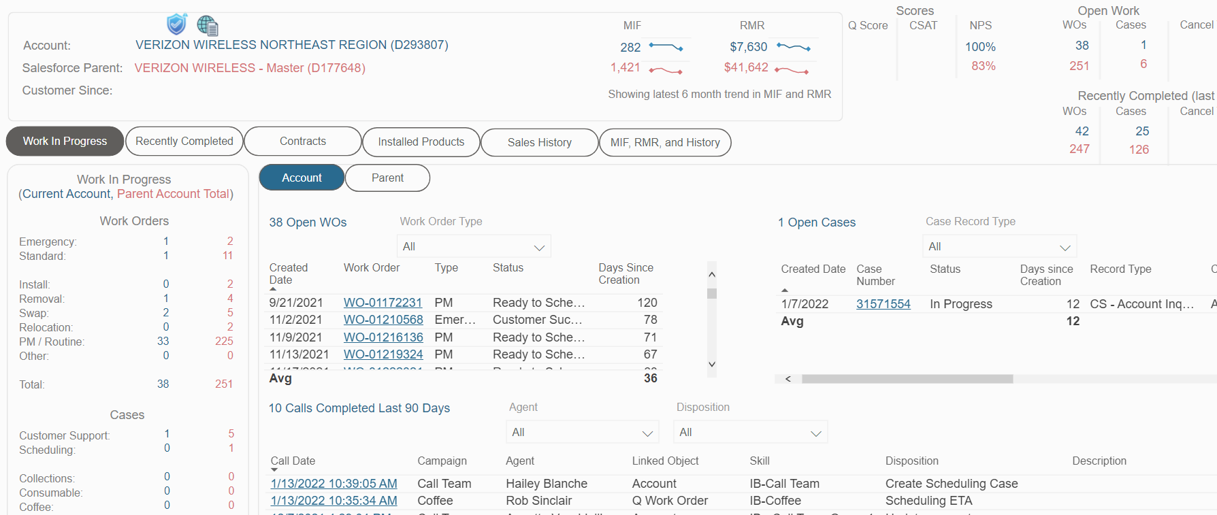
New tools – 360 account visibility
Account and Parent-level info
Recent Feedback
Toggle in-progress vs. recently completed
Open Work Orders
Open Cases
Recent Calls

Slide 17
When to expect Account Visibility
BI team has developed ‘Version 1.0’, based on Director feedback
Available to all reps within QForce on February 1st
Continuous improvements through a regular release cycle, based on your feedback and emerging business priorities

Slide 18
Enablement topics for today
What is ‘Sales Enablement?’
New Sales Tools + Visibility
Customer Service Transformation: Quality First
Overview of the Sales Enablement function and key goals for 2022
Introduction of new tools and data visibility for 2022
Overview of the Customer Service Transformation set to launch across Customer Care, Field Service, and Supply Chain

Slide 19
Starting point
Recognize our current challenges…
…while not overlooking our successes
Only 72% of Account Inquiry cases resolved within SLA in 2021
Install backlog increased on average by 82% from 2020 to 2021
$600K+ write off in 2021 due to inventory variance
Communication breakdowns internally and with customers, resulting in frustration
Drop in our customer Net Promoter Score
Churn ended the year at 7.4% - down near 2019 levels (from 8.9% end of 2020)
Record 23,300 installs completed in 2021
Additional 15,500 units added via M&A
Break-fix on-time rating increased from 79% to 85% (even with 9% higher volumes)
Need to improve, though important to remember our strengths

Slide 20
Customer Service transformation: Quality First
1
2
3
4
Right part, Right person, Right place, Right time
Structure Customer Care for success
Staff up to meet the needs
Measure ourselves as our customers do
Pivot in emphasis in the field to prioritize accurate count of local inventory and technician scheduling
Redesign customer care to enable timely first contact resolution across unique customer + case types
Add team members to match demand across field service, supply chain, scheduling, call team, and account management
Implement management metrics in-line with the customer experience – timely, frictionless

Slide 21
Core tenets of Field Service + Supply Chain redesign
Right part, Right person, Right place, Right time
Start with inventory accuracy – every day, every shed/warehouse
88 shed owners
Dedicated inventory control team
Re-define field service territories
Allocate equipment in the field to prevent unexpected reschedules
Dedicated unit for each install
Safety stock for emergent demand
Consolidate a new team of Sales Inventory + Operations Planning
Improve product availability communication
Tighter connection to order volumes
Continue to improve inventory availability
More product is on the way – will take time (5-month lead-time vs. usual 2)

Slide 22
Future state org chart – Supply Chain (As of 4/1)
Right part, Right person, Right place, Right time
Sales Inventory + Operations Planning
Inventory Management
DC Managers
TBH Manager
TBH Manager
88 Shed Owners
Procurement
Supply Planning
Demand Planning
Refurbishment
Inventory Management Team - PA
Expediting (narrowed focus)
Data Quality team
Manager – PA DC
Manager – CHI/FLA DC
Manager – LV DC
Transportation
Jim Hainsworth
TBH
Kara Bodison
Lane Barlow
4x Inv. Ctrl. Analyst - PA
Jim DiPiero
Kami Engle
Kim Banks
Tim Brown
Gary Hoopes
Ryan Dixon
David Bonthu
TBH
1x Inv. Ctrl. Analyst - CHI
Julia Harbaugh
Morgan Dlutz
NEW HIRING (February 1st 2022 vs. November 1st 2021)
1x Inv. Ctrl. Analyst - LV
Field Service:
+1 FSM
+20 Techs
Supply Chain:
+4 for Inventory Mgmt
+3 for Sales Ops/Planning
Director of Scheduling (dotted line reporting relationship from Expediting team)

Slide 23
Core tenets of Customer Care redesign
Structure Customer Care for success
Structure our account management teams for success based on customer type and case complexity
Onboarding customers
Major accounts, via a teamed approach
Case type; rapid resolution and complex case
Separate Scheduling and add a dedicated Director + Managers within Customer Care
Close linkage in personnel (1:1 - Scheduler:FSM) and in metrics
Focus our efforts on what matters to the customer:
Response and resolution time – how quickly did we first engage and resolve the case/WO?
First-time resolution in everything we do – did we resolve the customer’s issue?
Continuous improvement and learning to adjust and grow as we go

Slide 24
Future state org chart – Customer Care (As of 2/1)
Structure Customer Care for success
Director of Call Team + Consumables
Director of Acct Mgmt
Director of Scheduling
Marianne Muntz
Zachary Serabian
Tammi Breunig
Call Team Manager
Consumables Team Manager
Rapid Case Response team manager
Manager of Onboarding
Complex case team manager
Manager – Major accounts
Manager – Major Accounts
Manager – Scheduling
Manager – Scheduling
Manager – Scheduling
Lindsey Sokolski
Ebony Strother
Corey Zaslow
Lauren Marrero
Keyeona Seth
Mary Mruskovic
Mike McCourt
Denise Peronace
Frank Grillo
Kyrie Looby
2 supervisors
5x consumables reps
7x AMs
4x Proj. Mgrs.
10x AMs
18x Major Account AMs
~27 schedulers (1:1 with FSMs – to be finalized)
22x CT members
3x Onboarding AMs
NEW HIRING (February 1st 2022 vs. November 1st 2021)
1 dedicated WO creation rep
Customer care:
+1 Scheduling Manager
+4 Call Team members
+1 Project Manager
+5 Schedulers
+5 AMs

Slide 25
Escalation paths
I have an issue with a work order or equipment
Scheduling Managers will have a defined set of service markets and should be your first point of escalation
Escalation related to equipment should be funneled through the new expediting queue via email Expediting@Quenchwater.com
I have an issue with a Customer Case
New “Account Management Type” field will indicate the team and the Manager will be first point of escalation. The org chart will be distributed with Manager/Role
The 911 / QB process is still in place
New ‘Navigating Quench’ document to be distributed 1/31 to all team members

Slide 26
Taken together, these pillars deliver a radically improved customer experience…
Right part, Right person, Right place, Right time
Timely install dates on which we deliver – dramatically fewer last minute reschedules
Reduced inventory variance / write-off
Structure for Customer Care success
Faster case response time, with fewer cases ‘lost in the queue’
Improved scheduling consistency, clarity, and communication
Staff up to meet the needs
Fewer escalations
Focus on quality and completeness – the first time
Measure ourselves as our customers do
Increased customer satisfaction – less ‘friction’ in dealing with Quench
Additional customer feedback collection points

Slide 27
…and will take time
MAJOR MILESTONES
2/1: Rollout of new Customer Care structure – continue to refine and improve throughout Q1 + Q2
3/1: Continued improvement in Customer Care (e.g., additional IT deliveries) and initial pilot of Field Service + Supply Chain changes
4/1: Full rollout of new Field + SC structure – continue to refine and improve throughout Q2
Full benefits will take time – expect 2H 2022
This is the beginning phase of meaningful change for our customers and our employees – we need your engagement and feedback along the way to help us succeed

